Slide 1
DOM and Events
Lecturer: Ngo Huy Bien
Software Engineering Department
Faculty of Information Technology
VNUHCM - University of Science
Ho Chi Minh City, Vietnam
nhbien@fit.hcmus.edu.vn

Slide 2

Objectives
To implement UI interactions.
To retrieve data from servers.
To process JSON data.
To send JSON data to a server.

Slide 3

Contents
Window
Document
Element
Event Handling
Document Object Model (DOM)
XMLHttpRequest Objects
JavaScript Object Notation

Slide 4

References
Jon Duckett (2014). JavaScript and Jquery: Interactive Front-End Web Development. John Wiley & Sons.

Slide 5
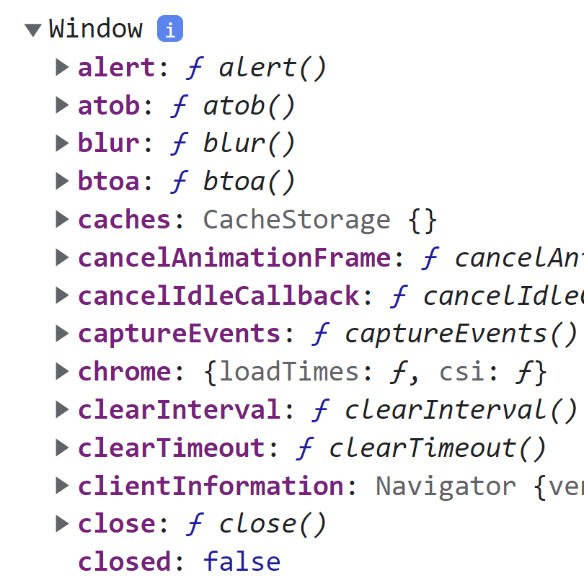
Hello Window
<!doctype html>
<html lang="en">
<head>
<title>Hello Window</title>
<script src="js/script.js"></script>
</head>
<body>
</body>
</html>
index.html
console.log(this);
console.log(window);
console.log(window instanceof Window);
console.log(Window);
js/script.js

Slide 6
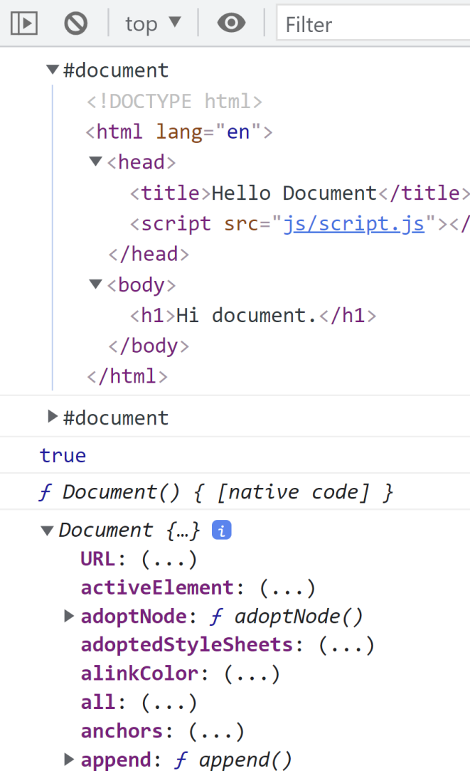
Hello Document
<!doctype html>
<html lang="en">
<head>
<title>Hello Document</title>
<script src="js/script.js"></script>
</head>
<body>
<h1>Hi document.</h1>
</body>
</html>
console.log(window.document);
console.log(document);
console.log(document instanceof Document);
console.log(Document);
console.log(Document.prototype);

Slide 7
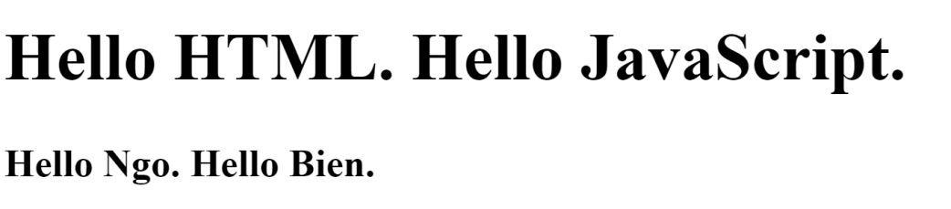
getElementById
<head>
<title>getElementById</title>
<script src="js/script.js" defer></script>
</head>
<body>
<h1 id = "myTitle"></h1>
<div id ="myContent"></div>
</body>
const myTitle = document.getElementById("myTitle");
myTitle.textContent = "Hello HTML. Hello JavaScript.";
const myContent = document.getElementById("myContent");
myContent.innerHTML = "<h3>Hello Ngo. Hello Bien.</h3>";

Slide 8
querySelector
<head>
<title>getElementById</title>
<script src="js/script.js" defer></script>
</head>
<body>
<h1 id = "myTitle"></h1>
<div id ="myContent"></div>
</body>
const myTitle = document.querySelector("#myTitle");
myTitle.textContent = "Hello HTML. Hello JavaScript.";
const myContent = document.querySelector("#myContent");
myContent.innerHTML = "<h3>Hello Ngo. Hello Bien.</h3>";

Slide 9
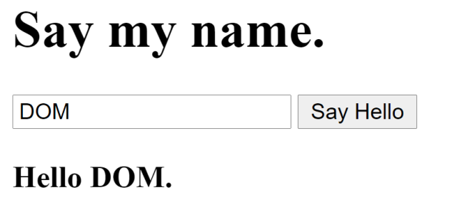
addEventListener
<body>
<h1 id="myTitle">Say my name.</h1>
<input type="text" id="txtName" />
<button id="btnSayHello">Say Hello</button>
<div id="myContent"></div>
</body>
const btnSayHello = document.getElementById("btnSayHello");
btnSayHello.addEventListener("click", sayHello);
function sayHello() {
const txtName = document.getElementById("txtName");
const myContent = document.getElementById("myContent");
myContent.innerHTML =
"<h3>Hello " + txtName.value + ".</h3>";
}

Slide 10
onclick
<body>
<h1 id="myTitle">Say my name.</h1>
<input type="text" id="txtName" />
<button onclick="sayHello();">Say Hello</button>
<div id="myContent"></div>
</body>
function sayHello() {
const txtName = document.getElementById("txtName");
const myContent = document.getElementById("myContent");
myContent.innerHTML =
"<h3>Hello " + txtName.value + ".</h3>";
}

Slide 11
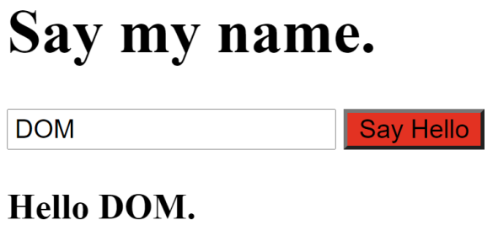
addEventListener and this
<body>
<h1 id="myTitle">Say my name.</h1>
<input type="text" id="txtName" />
<button id="btnSayHello">Say Hello</button>
<div id="myContent"></div>
</body>
const btnSayHello = document.getElementById("btnSayHello");
btnSayHello.addEventListener("click", sayHello);
function sayHello() {
this.style = "background-color: #FF0000;";
const txtName = document.getElementById("txtName");
const myContent = document.getElementById("myContent");
myContent.innerHTML =
"<h3>Hello " + txtName.value + ".</h3>";
}

Slide 12
onclick and this
<body>
<h1 id="myTitle">Say my name.</h1>
<input type="text" id="txtName" />
<button onclick="sayHello(this);">Say Hello</button>
<div id="myContent"></div>
</body>
function sayHello(caller) {
// this.style = "background-color: #FF0000;";
// console.log(this);
caller.style = "background-color: #FF0000;";
const txtName = document.getElementById("txtName");
const myContent = document.getElementById("myContent");
myContent.innerHTML =
"<h3>Hello " + txtName.value + ".</h3>";
}

Slide 13


Slide 14
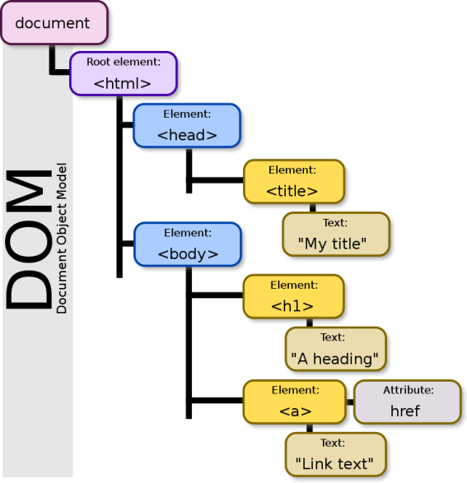
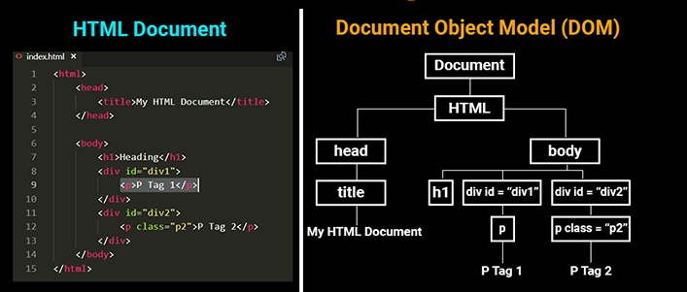
Document Object Model (DOM) [1]
When the browser loads a web page, it creates a model of the page in memory.
The DOM specifies the way in which the browser should structure this model using a DOM tree.
The DOM is called an object model because the model (the DOM tree) is made of objects.
The DOM also defines methods and properties to access and update each object in this model, which in turn updates what the user sees in the browser.

Slide 15

DOM, Browsers and JavaScript
The Document Object Model (DOM) specifies how browsers should create a model of an HTML page and how JavaScript can access and update the contents of a web page while it is in the browser window.
The DOM is neither part of HTML, nor part of JavaScript; it is a separate set of rules.
It is implemented by all major browser makers.

Slide 16
Document Object Model (DOM)
https://developer.mozilla.org/en-US/docs/Web/API/Document_Object_Model
The Document Object Model (DOM) represents a document with a logical tree.
DOM methods allow programmatic access to the tree. With them, you can change the document's structure, style, or content.

Slide 17
DOM Document
https://developer.mozilla.org/en-US/docs/Web/API/Document
The Document interface represents any web page loaded in the browser and serves as an entry point into the web page's content, which is the DOM tree.

Slide 18
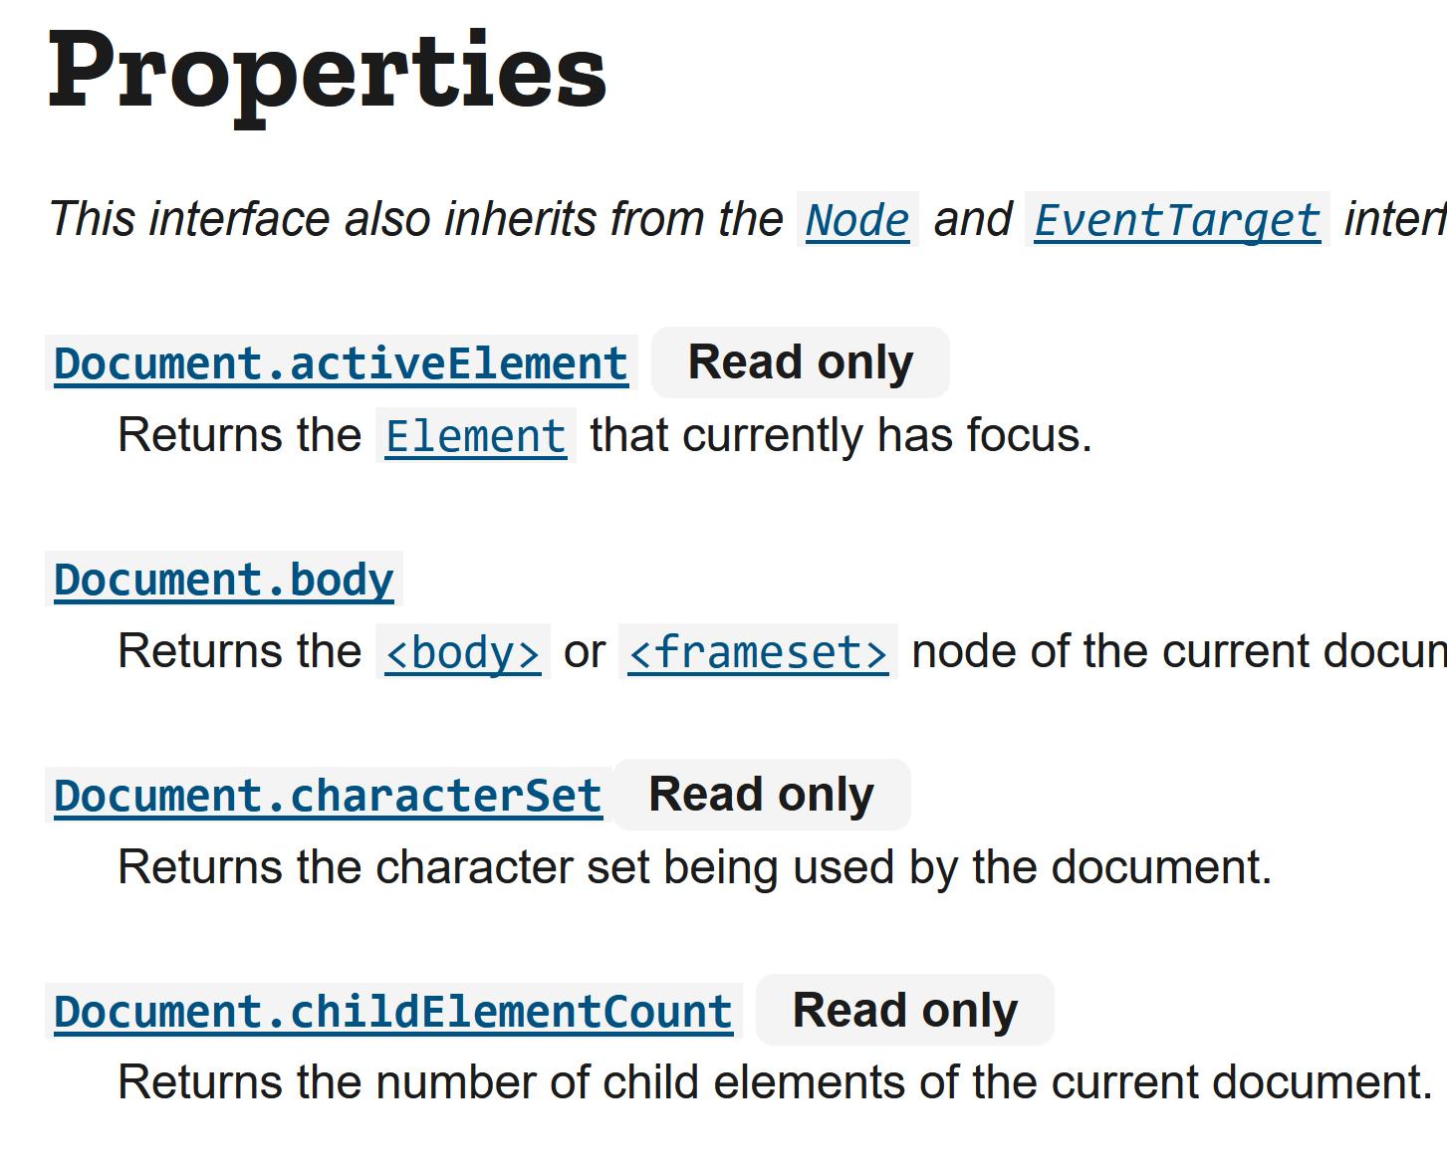

Document Properties and Methods
https://developer.mozilla.org/en-US/docs/Web/API/Document#properties

Slide 19
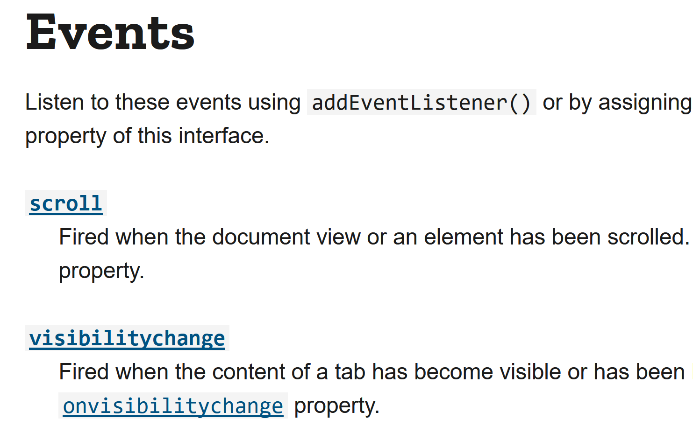
Document Events
https://developer.mozilla.org/en-US/docs/Web/API/Document#events

Slide 20
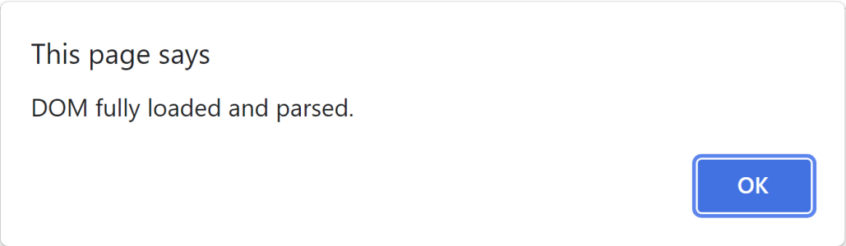
DOMContentLoaded Event
https://developer.mozilla.org/en-US/docs/Web/API/Document/DOMContentLoaded_event
The DOMContentLoaded event fires when the initial HTML document has been completely loaded and parsed, without waiting for stylesheets, images, and subframes to finish loading.
document.addEventListener("DOMContentLoaded",
function () {
window.alert("DOM fully loaded and parsed.");
}
);

Slide 21
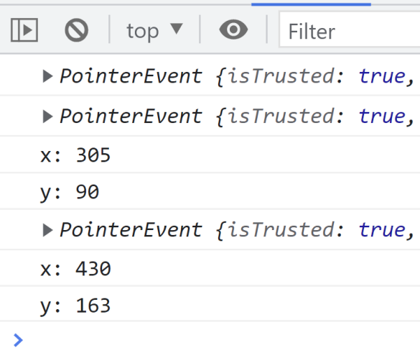
The 'event' Argument
https://developer.mozilla.org/en-US/docs/Web/API/PointerEvent
document.addEventListener("DOMContentLoaded",
document.querySelector("body")
.addEventListener("click",
function (event) {
console.log(event);
if (event.shiftKey === true) {
console.log("x: " + event.clientX);
console.log("y: " + event.clientY);
}
}
)
);

Slide 22
DOM Element
https://developer.mozilla.org/en-US/docs/Web/API/Element
Element is the most general base class from which all element objects (i.e. objects that represent elements) in a Document inherit.

Slide 23
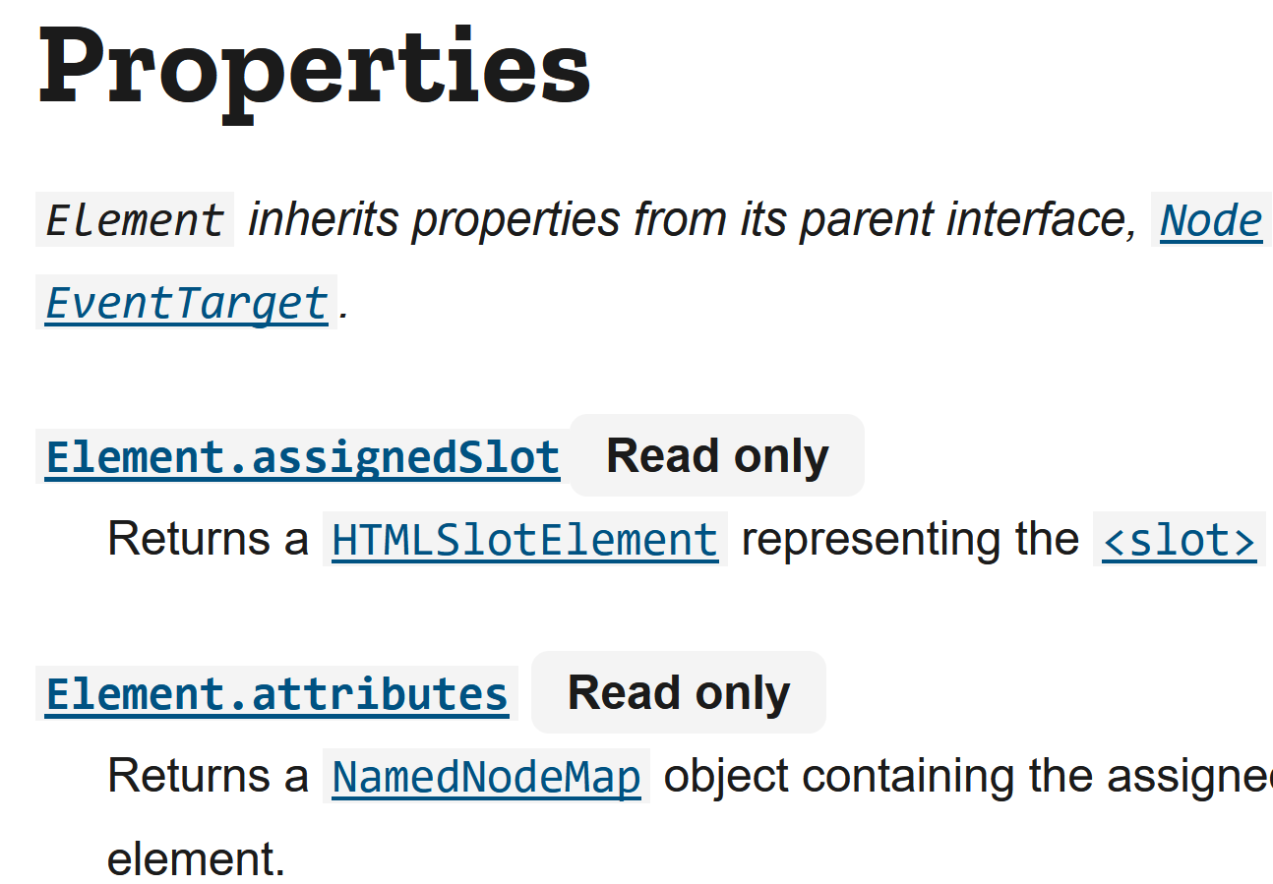
Element Properties and Methods
https://developer.mozilla.org/en-US/docs/Web/API/Element#properties

Slide 24
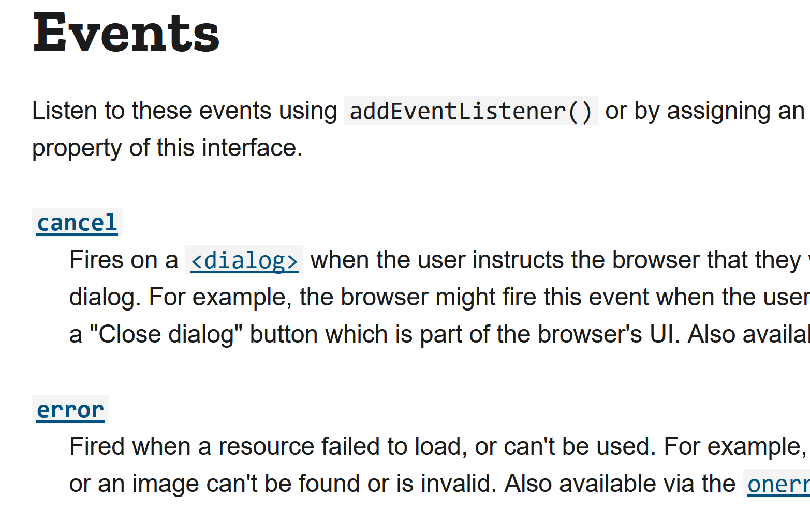
Element Events
https://developer.mozilla.org/en-US/docs/Web/API/Element#events

Slide 25
DOM Node
https://developer.mozilla.org/en-US/docs/Web/API/Node
The DOM Node interface is an abstract base class upon which many other DOM API objects are based, thus letting those object types to be used similarly and often interchangeably.

Slide 26
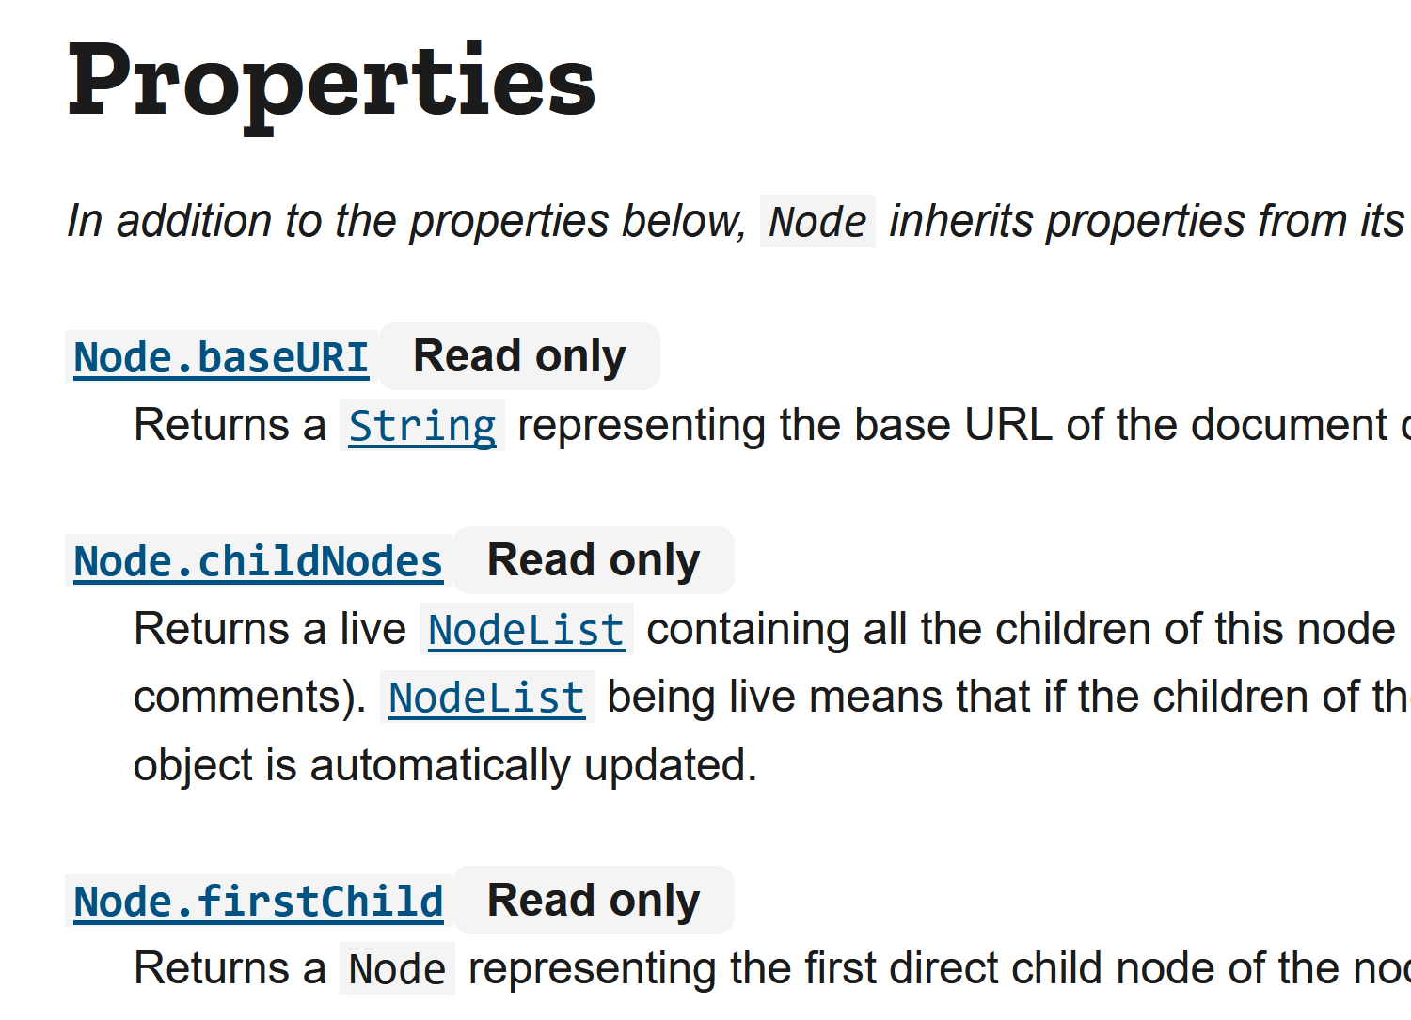
Node Properties
https://developer.mozilla.org/en-US/docs/Web/API/Node#properties

Slide 27
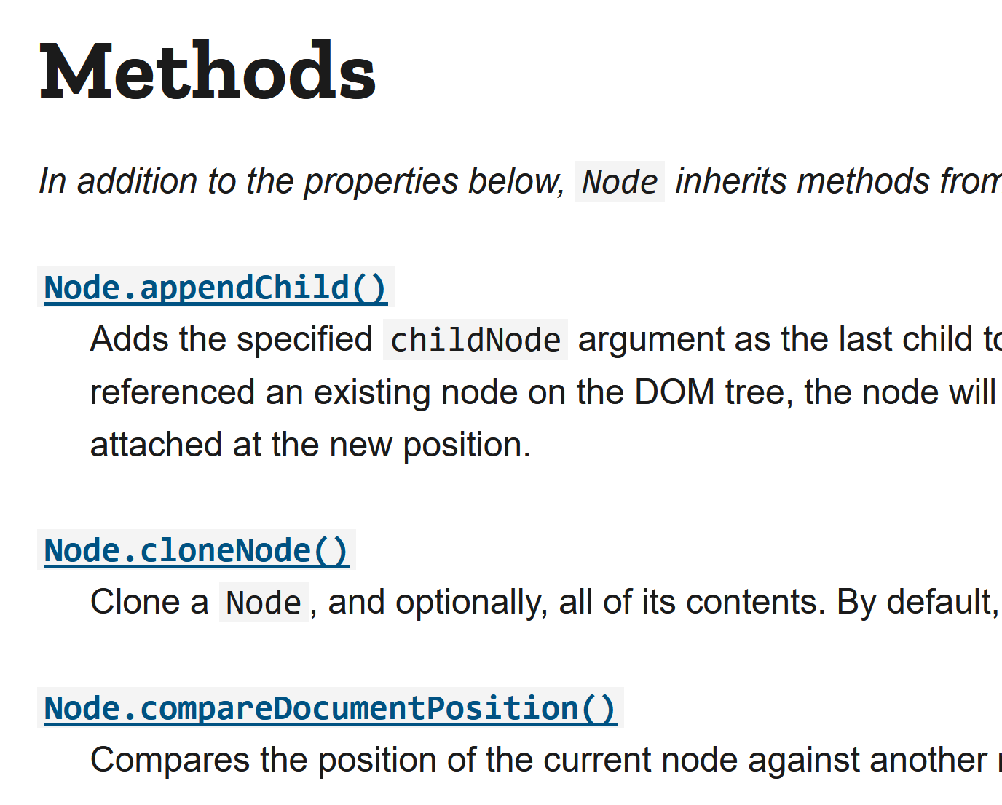
Node Methods
https://developer.mozilla.org/en-US/docs/Web/API/Node#methods

Slide 28
EventTarget
https://developer.mozilla.org/en-US/docs/Web/API/EventTarget
The EventTarget interface is implemented by objects that can receive events and may have listeners for them.
Element, and its children, as well as Document and Window, are the most common event targets.

Slide 29
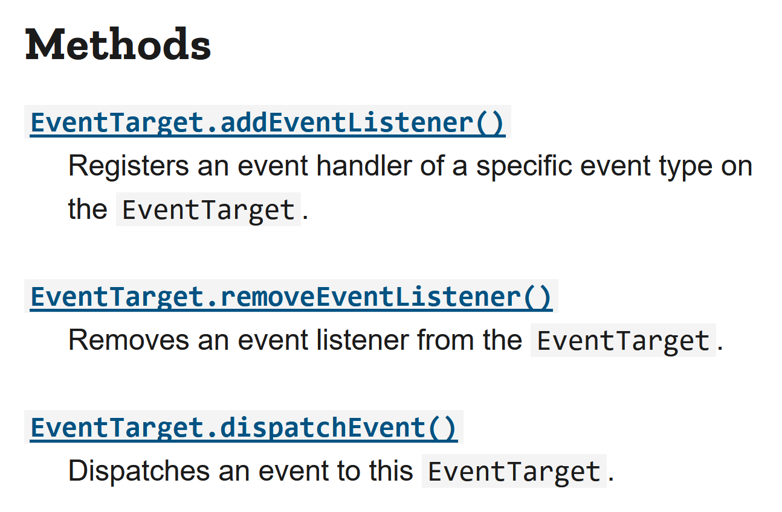
EventTarget Methods
https://developer.mozilla.org/en-US/docs/Web/API/EventTarget#methods

Slide 31
XMLHttpRequest Objects
https://developer.mozilla.org/en-US/docs/Web/API/XMLHttpRequest
XMLHttpRequest (XHR) objects are used to interact with servers.
You can retrieve data from a URL without having to do a full page refresh.
<body>
<button id = "myButton">
Retrieve server content
</button>
<div id="myContent"></div>
</body>

Slide 32
1. Prepare XMLHttpRequest
document.addEventListener(
"DOMContentLoaded", handleDOMContentLoaded
);
function handleDOMContentLoaded() {
const myButton = document.querySelector("#myButton");
myButton.addEventListener("click", function () {
const url =
"https://webappdevteacher.github.io/index.htm";
// const url = "https://example.com/index.html";
const method = "GET";
const request = new XMLHttpRequest();
request.open(method, url, true);
// async = true
// https://developer.mozilla.org/en-US/docs/Web/API/XMLHttpRequest/open

Slide 33
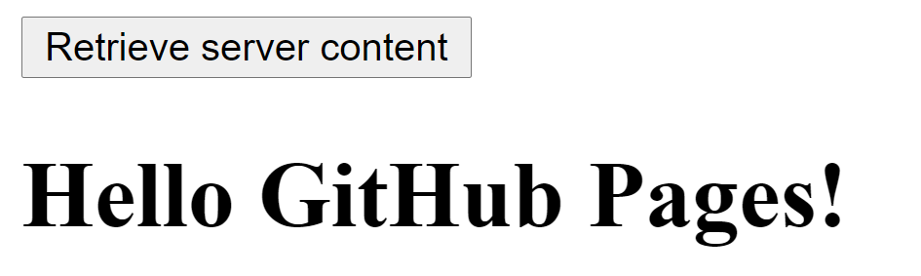
2. Send XMLHttpRequest
request.onreadystatechange = function() {
if (XMLHttpRequest.DONE === request.readyState) {
const status = request.status;
if (status === 0 ||
(status >= 200 && status < 400)) {
const content = request.responseText;
document.querySelector("#myContent")
.innerHTML = content;
}
}
}; request.send();
// const content = request.responseText;
// document.querySelector("#myContent")
// .innerHTML = content;
}
)
}
Asynchronous call
No 'Access-Control-Allow-Origin' header

Slide 34
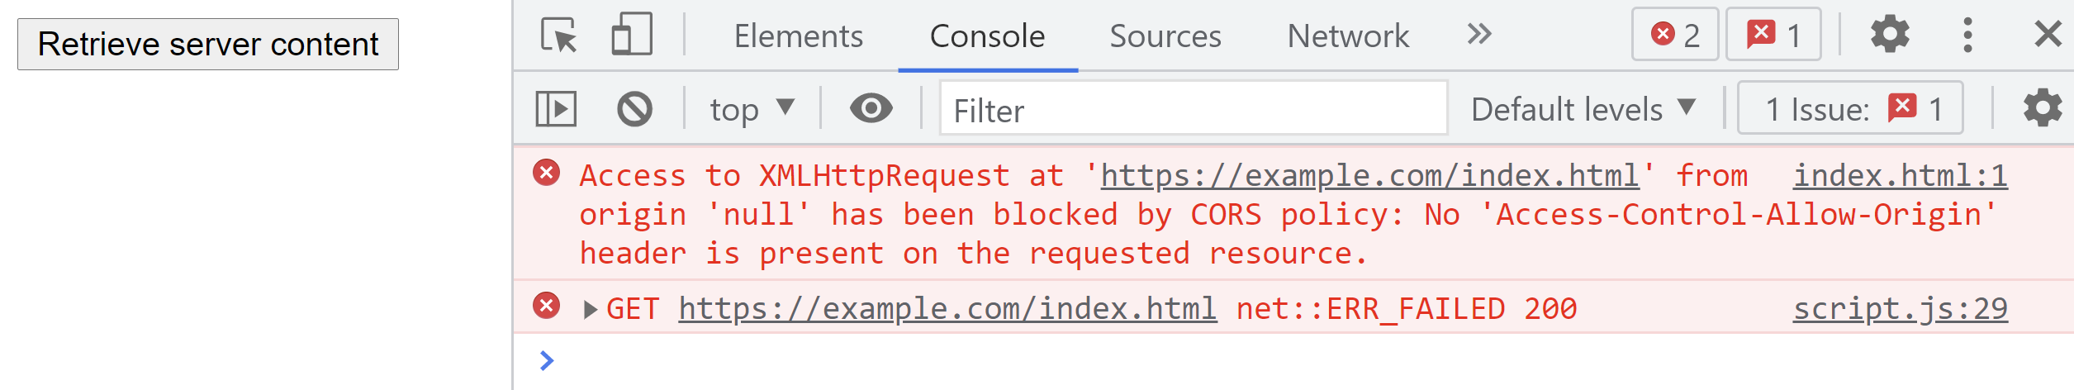
No 'Access-Control-Allow-Origin'
What is this?

Slide 35
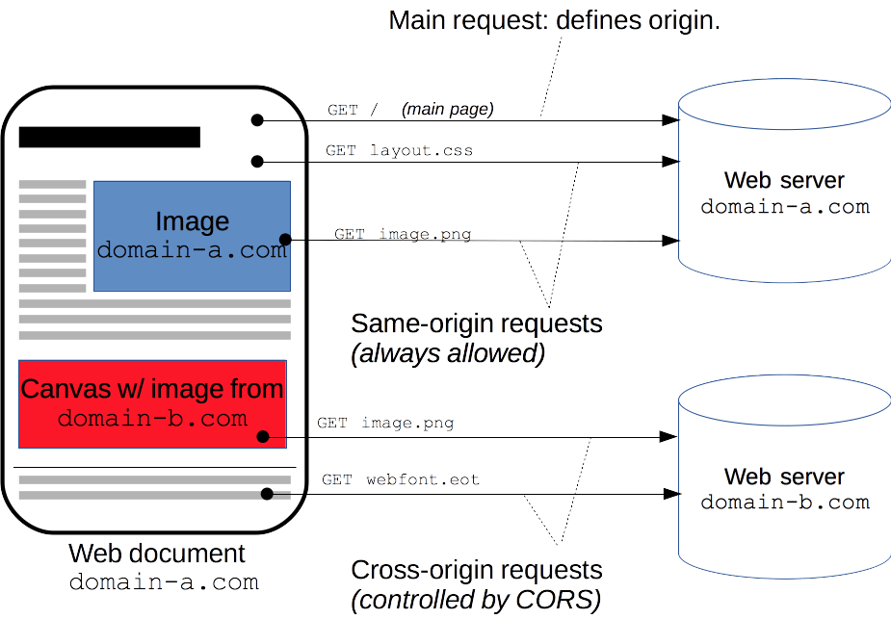
What is Cross-Origin Resource Sharing?
https://developer.mozilla.org/en-US/docs/Web/HTTP/CORS
Cross-Origin Resource Sharing (CORS) is an HTTP-header based mechanism that allows a server to indicate any origins (domain, scheme, or port) other than its own from which a browser should permit loading resources.
An example of a cross-origin request: the front-end JavaScript code served from https://domain-a.com uses XMLHttpRequest to make a request for https://domain-b.com/data.json.

Slide 36
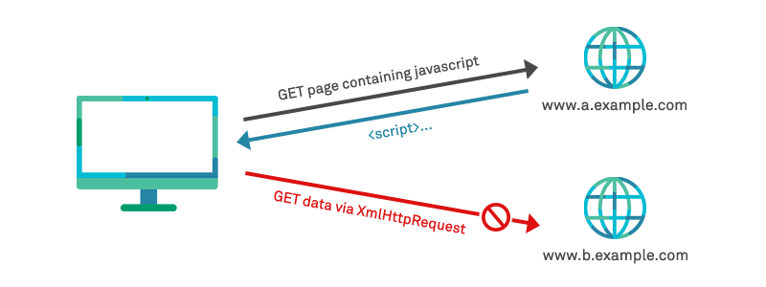
CORS and Security
If CORS is enabled then any site can make a request to your site on behalf of their visitors and process its response.
If you have something implemented like an authentication or authorization scheme that is based on something that is automatically provided by the browser (cookies, cookie-based sessions, HTTP basic auth, and TLS client certificates), the requests triggered by the third party sites will use them too.

Slide 37
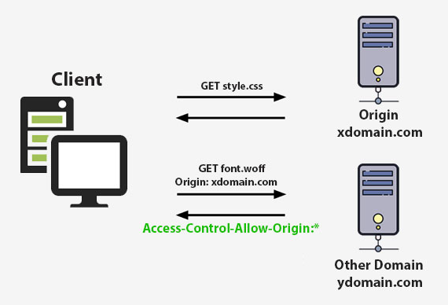
Default CORS Behavior of Browsers
For security reasons, browsers restrict cross-origin HTTP requests initiated from scripts.
For example, XMLHttpRequest follows the same-origin policy.
This means that a web application using XMLHttpRequest can only request resources from the same origin the application was loaded from unless the response from other origins includes the right CORS headers.

Slide 38
CORS information
CORS information (like the Origin header) is sent by browsers.
These are automatically added by browsers when JavaScript running on a web page makes a cross-origin request.
Header | Sent by | Purpose
Origin | Browser | Identifies where the request originated (scheme, host, port).
Access-Control-Request-Method | Browser (preflight) | Says which HTTP method (e.g., POST, DELETE) will be used in the actual request.
Access-Control-Request-Headers | Browser (preflight) | Says which custom headers the browser wants to send.

Slide 39
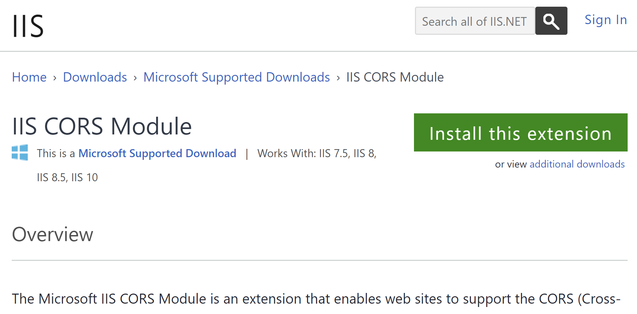
1. Install IIS CORS Module
https://www.iis.net/downloads/microsoft/iis-cors-module
The Microsoft IIS CORS Module is an extension that enables web sites to support the CORS (Cross-Origin Resource Sharing) protocol.

Slide 40
2. Enable CORS in IIS
https://blogs.iis.net/iisteam/getting-started-with-the-iis-cors-module
<system.webServer>
<httpProtocol>
<customHeaders>
<add name="Access-Control-Allow-Headers" value="Origin, X-Requested-With, Content-Type, Accept" />
</customHeaders>
</httpProtocol>
<cors enabled="true">
<add origin="*" />
</cors>
</system.webServer>

Slide 41

Is it Safe to Enable CORS?
Access-Control-Allow-Origin is just a HTTP header sent from the server to the browser.
The regular browsers (Chrome, Edge, Firefox, Safari and Opera) by default honor the header.
But an application like Postman simply ignores it.
The server end doesn't check what the "origin" is of the request when it returns the response.
So if anyone wants to attack you, they can easily bypass the Access-Control-Allow-Origin by using a specific application and just ignoring the Access-Control-Allow-Origin header.

Slide 43
JavaScript Object Notation
https://www.json.org/json-en.html
JSON (JavaScript Object Notation) is a lightweight data-interchange format.
It is easy for humans to read and write.
It is easy for machines to parse and generate.
JSON is a text format that is completely language independent.
// Subset of JavaScript object literal syntax... except that
// Property names must be in double quotes.
// String values must be in double quotes.
// Syntax for everything else is exactly like for object literal.
const jsonText = '{"name": "John", "age": 30, "single": false}';
console.log(jsonText);

Slide 44
Another JSON Example
const jsonText =
`{
"name": "John",
"age": 30,
"single": false,
"hobbies": [
{
"name": "marathon",
"start year": 2018
},
{
"name": "ping-pong",
"start year": 2006
}
]
}`;
console.log(jsonText);

Slide 45
Real World JSON Example
const jsonText =
`{
"CompanyKey": "QiZMUinoJnhCVhE",
"From": "test1@domain.com",
"To": "test2@domain.com",
"Subject": "Test Subject",
"Message": "Test Message",
"Attachments" : [
{ "FileName": "ABC.txt", "MimeType": "text/plain", "FileContent": "123" },
{ "FileName": "DEF.pdf", "MimeType": "application/pdf", "FileContent": "456" }
]
}`;
console.log(jsonText);

Slide 46
Encode to Base64 Format
https://www.base64encode.org/
Base64 encoding schemes are commonly used when there is a need to encode binary data, especially when that data needs to be stored and transferred over media that are designed to deal with text.
This encoding helps to ensure that the data remains intact without modification during transport.
Example:
https://example.com → aHR0cHM6Ly9leGFtcGxlLmNvbQ==

Slide 47
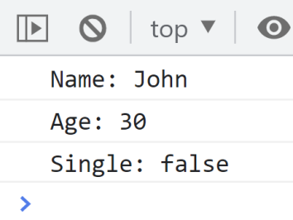
Restoring JavaScript Objects
function restoreObject() {
// JSON is NOT a JavaScript Object Literal.
// JSON is just a string.
// We need to covert JSON into a JS object.
const jsonText =
`{"name": "John", "age": 30, "single": false}`;
// This function uses the JSON data interchange format.
const john = JSON.parse(jsonText);
console.log("Name: " + john.name);
console.log("Age: " + john.age);
console.log("Single: " + john.single);
}
restoreObject();

Slide 48
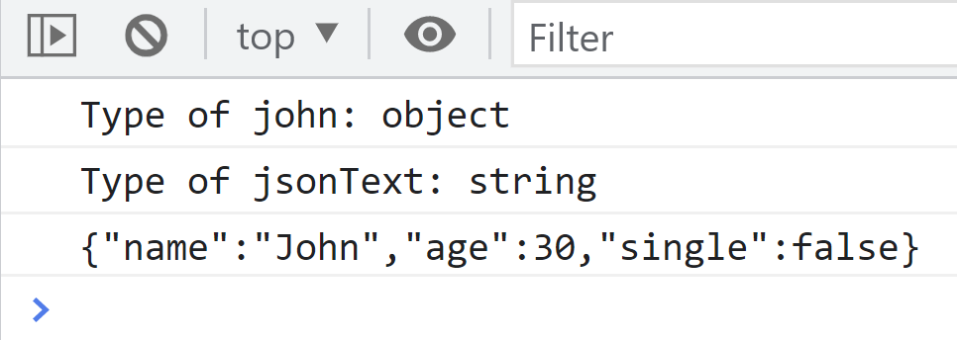
Serializing JavaScript Objects
Object serialization is the process of converting an object’s state to a string from which it can later be restored.
function serializeObject() {
const john = {"name": "John", "age": 30, "single": false};
console.log("Type of john: " + typeof john);
const jsonText = JSON.stringify(john);
console.log("Type of jsonText: " + typeof jsonText);
console.log(jsonText);
}
serializeObject();

Slide 49
1. Prepare a GET Request
document.addEventListener(
"DOMContentLoaded", handleDOMContentLoaded
);
function handleDOMContentLoaded() {
const myButton = document.querySelector("#myButton");
myButton.addEventListener("click", function () {
const url =
"https://webappdevteacher.github.io/data.json";
const method = "GET";
const request = new XMLHttpRequest();
request.open(method, url, true);

Slide 50
2. Handle Response
request.onreadystatechange = function() {
if (XMLHttpRequest.DONE === request.readyState) {
const status = request.status;
if (status === 0 ||
(status >= 200 && status < 400)) {
const content = request.responseText;
const donuts = JSON.parse(content);
const html = prepareHTML(donuts);
document.querySelector("#myContent").
innerHTML = html;
}
}

Slide 51
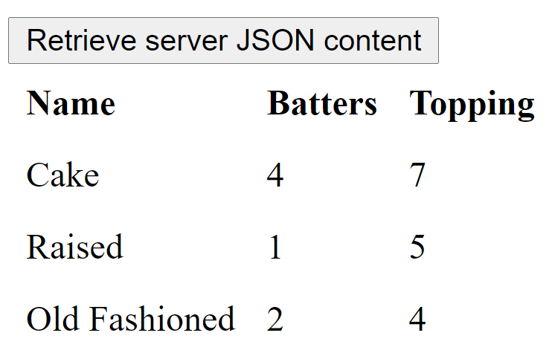
3. Send the Request and Process Data
function prepareHTML(donuts) {
let html = "<table><tr>";
html += "<th>Name</th><th>Batters</th><th>Topping</th>";
html += "</tr>";
for(var i = 0; i < donuts.length; i++) {
html += "<tr>";
html += "<td>" + donuts[i].name + "</td>";
html += "<td>" + donuts[i].batters.length + "</td>";
html += "<td>" + donuts[i].topping.length + "</td>";
html += "</tr>";
}
html += "</table>";
return html;
}
};
request.send();
}
)
}

Slide 53
1. Prepare a POST Request
document.addEventListener(
"DOMContentLoaded", handleDOMContentLoaded
);
function handleDOMContentLoaded() {
const myButton = document.querySelector("#myButton");
myButton.addEventListener("click", function () {
const url =
"http://example.com/SendMessage";
const method = "POST";
const request = new XMLHttpRequest();
request.open(method, url, true);
request.setRequestHeader("Content-Type",
"application/json;charset=UTF-8");

Slide 54
2. Handle Response
request.onreadystatechange = function() {
if (XMLHttpRequest.DONE === request.readyState) {
const status = request.status;
if (status === 0 ||
(status >= 200 && status < 400)) {
const content = request.responseText;
document.querySelector("#myContent")
.innerHTML = content;
}
}
};

Slide 55
3. Send Data
var message = {
"CompanyKey": "XQAlnfp1RLXXQiZMUinoJnhCVhE",
"From": "test1@domain.com",
"To": "test2@domain.com",
"Subject": "Test Subject",
"Message": "Test Message"
}
request.send(JSON.stringify(message));

Slide 56

Further Reading
https://developer.mozilla.org/en-US/docs/Web/API
Jon Duckett (2014). JavaScript and JQuery: Interactive Front-End Web Development. John Wiley & Sons: Chapter 5 and Chapter 6.

Slide 57

Thank You & See You Again

